Slide 1


UCI AIR QUALITY UNIVARIATE AND MULTIVARIATE STUDY
IRONHACK DAFT AUG22 “Data Analytics” Midterm Project Presentation
Team Member: Rodrigo Franco, Gunnar David
CONFIDENTIAL

Slide 2


Meet the UCI AQ Team!
Rodrigo Franco
Home Country: Paraguay
Post-Ironhack Industry: Consulting
Programming language: Python
Gunnar David
Home Country: Germany
Post-Ironhack Industry: Consulting
Programming language: Python, R, JavaScript, HTML5 & CSS3

Slide 3

Friday, the 09th of September Time: TBA Zoom: TBA

Slide 4
Objective 1:
1.1 Exploration & Visualization of the UCI AQ Dataset
1.2 Univariate Regression Model for Relative Humidity
Main Question here:
How does relative humidity changes relative to the air pollutants concentration?
Does the regressor estimator model bag perform better when we have a larger dataset, more complex features, i.e, big data (a.k.a. is the model scalable)?
Do simpler regression modules perform well/ robust for small amount of data (why, i.e. variance/bias)? Does it generalizes & scale generally well into the big-data domain?
9357 Records
1 Datetime (1 Year Data)
12 Features: Gaskonzentration in der Luft
1 Target Variable: Relative Feuchtigkeit
Models:
Sklearn: Linear Regression (Naïve Model)
Model Bag: Sklearn Regression Estimators/XGBoost/LightGBM: Performance Modelling
Evaluation:
RMSLE (root mean squared logarithmic error)
Deployment Language: Python3 .py
Objective 2:
Multivariate Regression ANN & DNN Model for Air Quality with Tensorflow/Keras
Main Question here:
Does the DNN performs better when we have a larger dataset, more complex feautres, i.e, big data. Whereas simpler regression modules perform well for small amount of data but it generally does not generalize well into the big-data era.
9357 Records
1 Datetime (1 Year Data)
12 Features: Gaskonzentration in der Luft
5 Target Variable: Ground Truth Gaskonzentrations Messung (CO, Non-Methane Hydrocarbons, Benzene, NOx, NO2)
Models:
Tensorflow with Keras: Linear Regression (Naïve Model)
Tensorflow with Keras: Multivariate Regression Model (Polynomial) and DNN 3-layers
Evaluation:
Cost function (gradient decent)
Deployment Language: Python3 .py

Slide 5





UCI AIR QUALITY UNIVARIATE AND MULTIVARIATE STUDY
Ironhack DAFT AUG22 “Data Analytics” Midterm Project Presentation
Team Member: Rodrigo Franco, Gunnar David
Add corporate partner SAP
CONFIDENTIAL

Slide 6

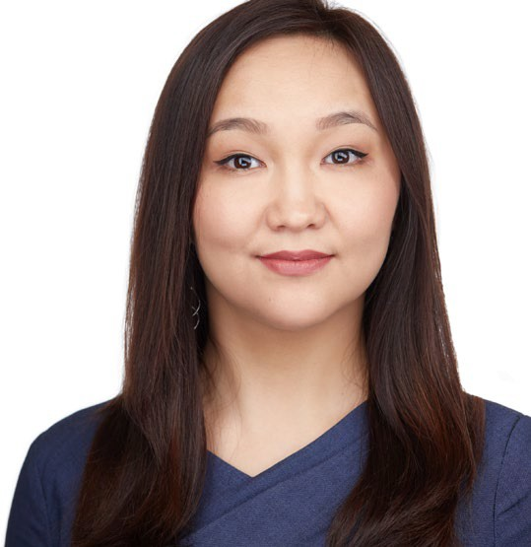
Meet the UCI AQ Team!
Rodrigo Franco
Home Country: Paraguay
Post-Ironhack Industry: Consulting
Programming language: Python
Gunnar David
Home Country: Germany
Post-Ironhack Industry: Consulting
Programming language: Python, R, JavaScript, HTML5 & CSS3
Edit Canva white background/ rectangle

Slide 7
Contents
Project Overview
Objective
Data preview
Analytics Roadmap
Analysis process
Price response function
Regression models
Output
Visualization
Observations
Recommendations

Slide 8

Project Overview

Slide 9




We want to help Beiersdorf make more informed decisions on its pricing strategies
What are the price elasticities for Beiersdorf wound protection products?
What important factors impact demand and how?
How does Beiersdorf differ in price sensitivity from other competitor brands?
What is the optimal pricing strategy for Beiersdorf?

Slide 10
Our analysis focuses on 3 measures and 4 dimensions derived from rawdata, combined with 3 exogenous factors
51,487 Rows (weekly entries per SKU)
8 Meaningless Variables
Year Month (Sep16 – Sep19)
Year Week 4 Seasons
9 Contributing Dimensions
3 Segments
7 Sub-Segments
61,402 Rows
619 SKU
Numbers
22 Columns
4 Manufacturers
16 Brands
49 Product Lines
363 Product Names
Volume
(& Normalized Volume)
3 Exogenous Factors:
CPI
Temp
Sunshine
Price
5 Measures
Value
(& Value in LC)
TDP

Slide 11
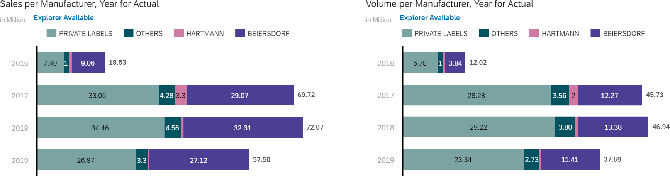
Beiersdorf and Private Labels are the main players in the German wound protection market
Beiersdorf products are more premium with higher price points.

Slide 12
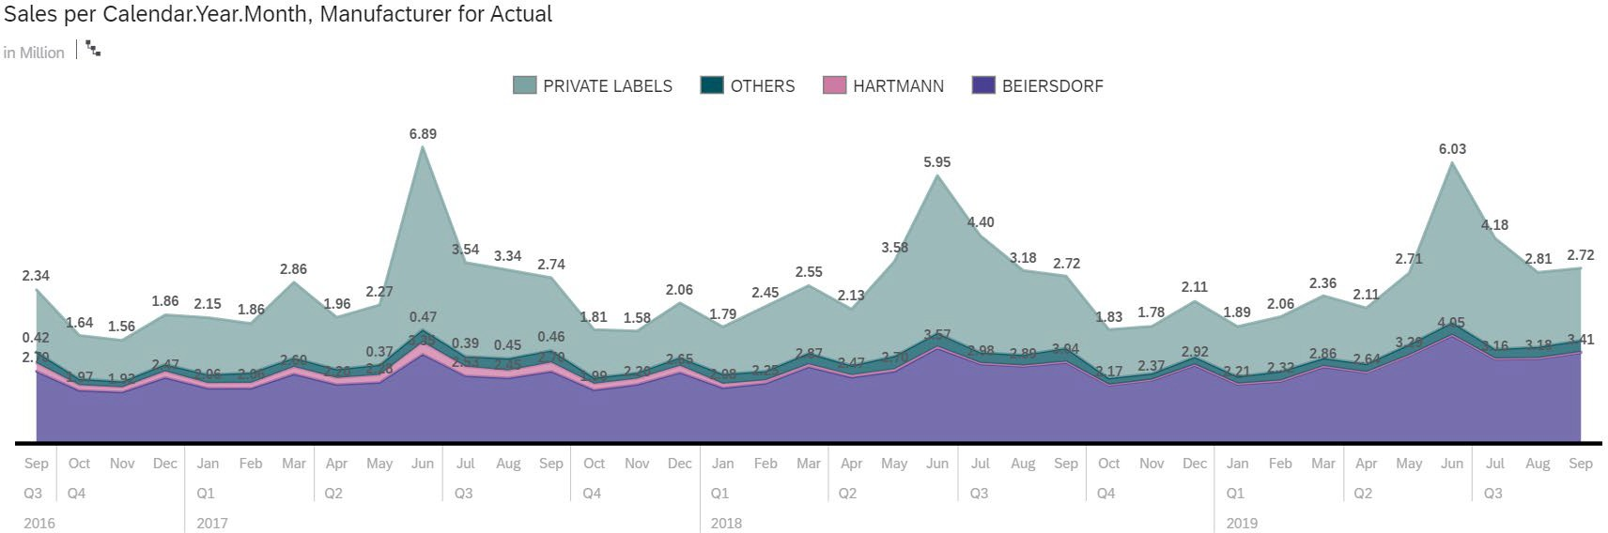
Sales appears to have seasonality across brands
June has the highest sales in all 3 years.

Slide 13
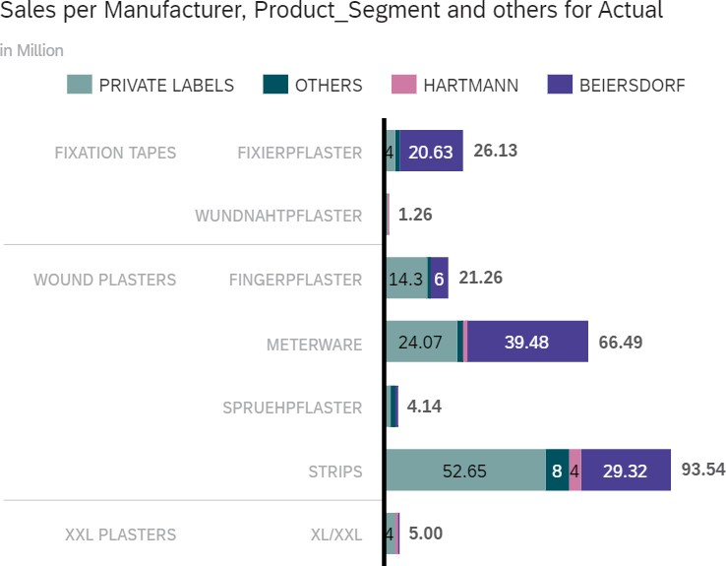
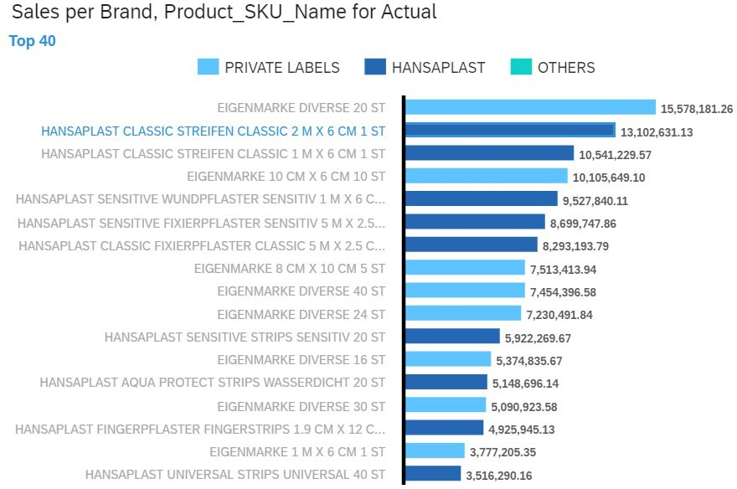
Top 40 products represented 80% of the total sales
Strips and Meterware are the top 2 sub-segments for sales.

Slide 14

Analytics Roadmap

Slide 15
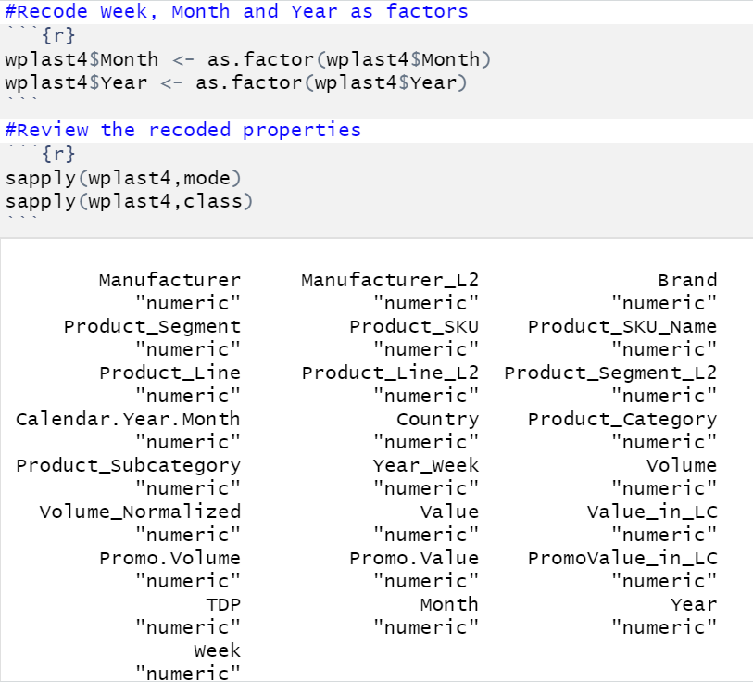
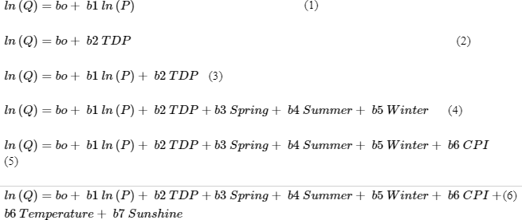
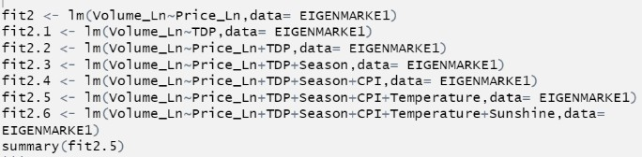
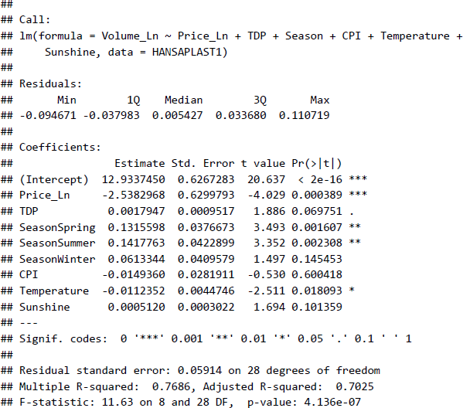
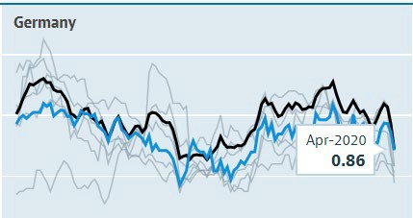
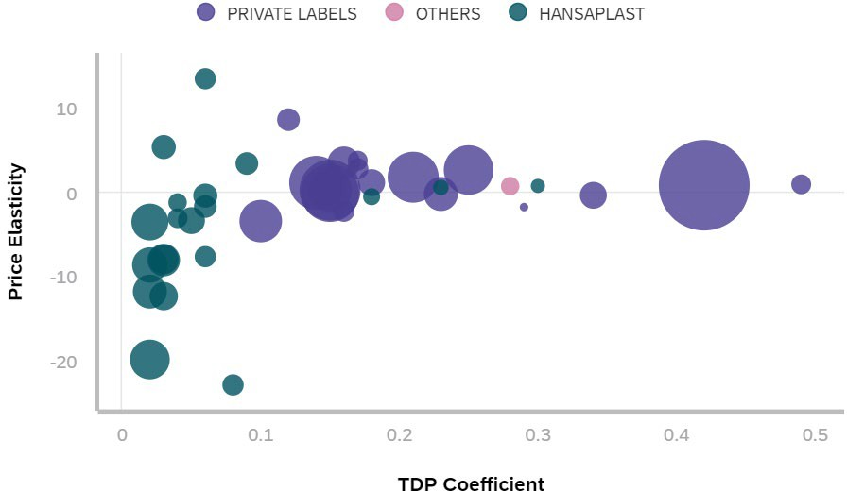
We used R cloud for analysis and SAC for visualization
1
Data cleaning
2
Data preparation
3
Modeling in R
4
Visualization
Remove redundant columns
Consolidate weekly data
Coerce data types
Create new variables
Log transformation
Combine macro data
Create subsets
Plot scatter charts
Run Regressions
Regression outputs
Aggregation charts
Observation & analysis
Combo Adj R2 HANSAPLAST AQUA PROTECT STRIPS 20 ST 87.1% HANSAPLAST SENSITIVE STRIPS 20 ST 84.8% HANSAPLAST UNIVERSAL STRIPS 40 ST 83.3% HANSAPLAST DRK MIX PACK DIVERSE 20 ST 89.6% HANSAPLAST WATERPROOF 16 ST 72.7% HANSAPLAST STREIFEN ELASTIC 20 ST 69.8% HANSAPLAST SILICONE SOFT DIVERSE 8 ST 61.9% HANSAPLAST KIDS FROZEN DIVERSE 16 ST 71.1% EIGENMARKE DIVERSE 20 ST 51.3% EIGENMARKE 8 CM X 10 CM 5 ST 56.0% EIGENMARKE DIVERSE 40 ST 36.4% EIGENMARKE DIVERSE 24 ST 64.8% EIGENMARKE DIVERSE 16 ST 74.1% EIGENMARKE WUNDSCHNELLVERBAENDE 67.3% EIGENMARKE DIVERSE 30 ST 16.7% EIGENMARKE DIVERSE 10 ST 73.1% FIGO ERSTE HILFE DIVERSE 36 ST 76.0% | Price_Ln |  | TDP |  | Spring |  | Summer |  | Winter |  | CPI |  | Temperature |  | Sunshine
 | Coeff Sign |  | Coeff Sign |  | Coeff Sign |  | Coeff Sign |  | Coeff Sign |  | Coeff Sign |  | Coeff Sign |  | Coeff Sign
 | (6.76) (4.72) 0.11 (8.04) (6.33) (1.64) (21.68) (0.78) (0.16) 1.40 0.33 (0.68) 3.51 (4.36) (0.31) (0.43) 1.19 | Yes Yes | 0.031 0.027 0.060 0.052 0.050 0.050 0.063 0.198 0.146 0.144 0.208 0.188 0.168 0.086 0.228 0.336 0.277 | Yes | (0.010) (0.016) 0.023 0.132 0.041 0.150 0.281 0.434 (0.083) 0.204 0.096 | No | 0.369 0.299 0.345 0.334 0.413 0.376 0.615 0.589 0.079 0.536 0.369 (0.168) 0.592 (0.992) 0.064 0.171 0.988 | Yes | 0.044 (0.021) (0.005) 0.144 (0.018) 0.019 0.133 0.381 0.065 (0.278) 0.058 0.157 (0.445) | No | 0.037 0.029 (0.006) 0.156 0.173 0.221 0.078 0.380 0.118 (0.102) (0.350) 0.481 0.460 (0.071) 0.032 (0.319) (0.281) | No | (0.002) (0.007) (0.005) 0.006 0.001 0.002 (0.010) (0.051) 0.012 (0.102) 0.026 0.120 (0.034) 0.267 (0.004) (0.011) (0.067) | No | 0.001 0.001 0.001 0.001 0.000 0.000 0.002 0.002 0.000 0.004 (0.002) 0.003 0.002 0.002 (0.000) 0.003 0.004 | Yes
 |  |  |  | Yes |  | No |  | Yes |  | No |  | No |  | No |  | Yes
 |  | No |  | Yes |  | No |  | Yes |  | No |  | No |  | No |  | Yes
 |  | Yes Yes |  | Yes |  | Yes |  | Yes |  | No |  | Yes |  | No |  | Yes
 |  |  |  | Yes |  | No |  | Yes |  | No |  | Yes |  | No |  | No
 |  | No |  | Yes |  | Yes |  | Yes |  | No |  | Yes |  | No |  | No
 |  | Yes |  | Yes |  | No |  | Yes |  | No |  | No |  | No |  | No
 |  | Yes |  | Yes |  | Yes |  | Yes |  | Yes |  | Yes Yes |  | Yes |  | No
 |  | Yes |  | Yes |  | No |  | No |  | No |  |  |  | No |  | No
 |  | Yes |  | Yes |  | No |  | Yes Yes |  | No |  | No |  | Yes |  | Yes
 |  | Yes |  | Yes |  | No |  |  |  | No |  | Yes |  | No |  | No
 |  | No |  | Yes | - NA |  |  | No |  | No |  | No |  | No |  | No
 |  | Yes |  | Yes | (0.154) 1.497 0.086 (0.119) 0.395 | No |  | Yes Yes |  | Yes |  | Yes |  | No |  | No
 |  | Yes |  | Yes |  | Yes |  |  | - NA |  |  | No No |  | Yes |  | No
 |  | Yes |  | Yes |  | No No |  | No No | 0.076 0.071 (0.130) | No |  |  |  | No No |  | No
 |  | Yes |  | Yes |  |  |  |  |  | No |  | Yes Yes |  |  |  | Yes Yes
 |  | No |  | Yes |  | Yes |  | Yes |  | No |  |  |  | Yes

Slide 16
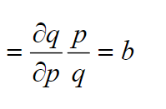
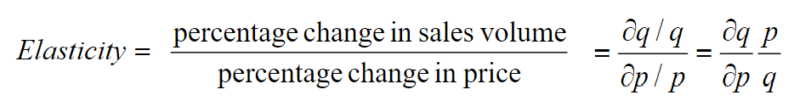
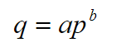
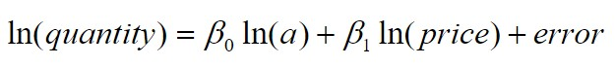
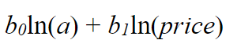
We assumed a non-linear, constant elasticity relationship between demand and price to run regressions
Log-Log transformation
Estimated demand function

Slide 17
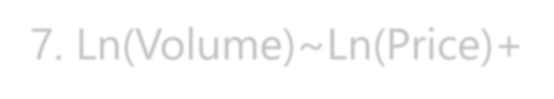
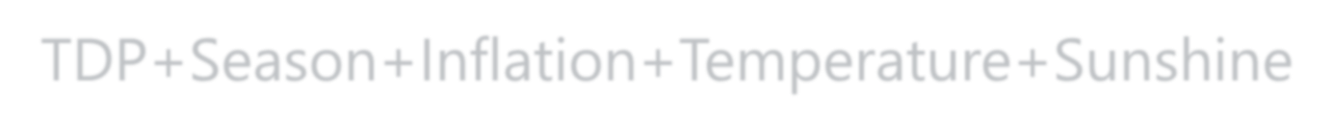
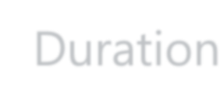

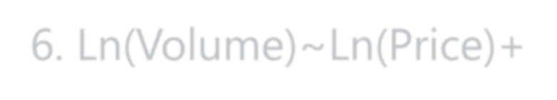
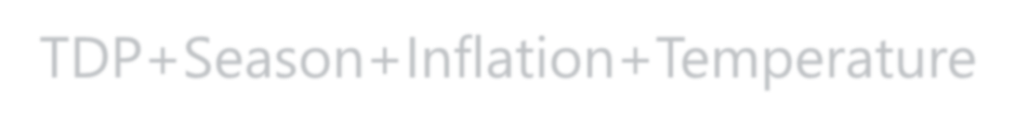
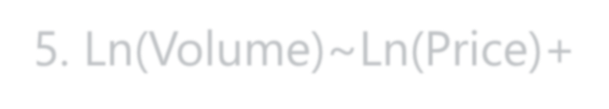
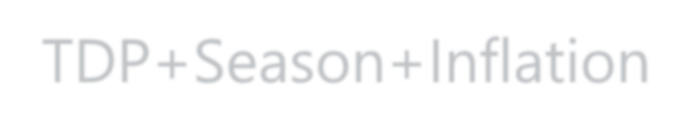
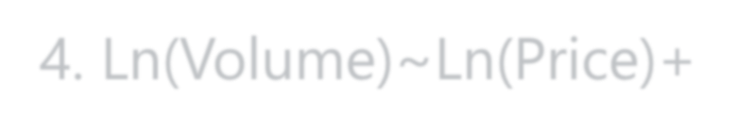
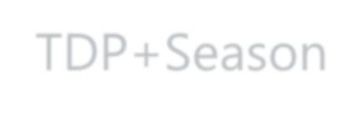
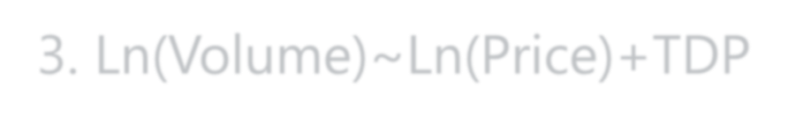
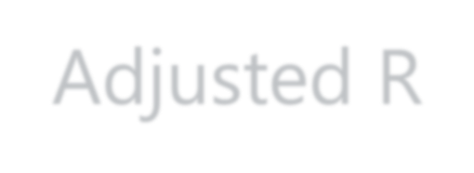
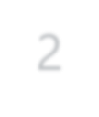
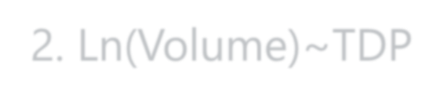
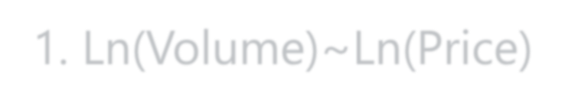
328 regressions to ID price elastic/inelastic products and other critical variables that influence purchasing decisions
7. Ln(Volume)~Ln(Price)+TDP+Season+Inflation+Temperature+Sunshine Duration
6 Segments + 8 Step Regressions (+Brand)
=> Brand Influence
6. Ln(Volume)~Ln(Price)+TDP+Season+Inflation+Temperature
5. Ln(Volume)~Ln(Price)+TDP+Season+Inflation
328 Regressions
4. Ln(Volume)~Ln(Price)+TDP+Season
3. Ln(Volume)~Ln(Price)+TDP
Adjusted R²
40 Product Keys + 7 Step Regressions
=> Price Elasticity
2. Ln(Volume)~TDP
1. Ln(Volume)~Ln(Price)

Slide 18
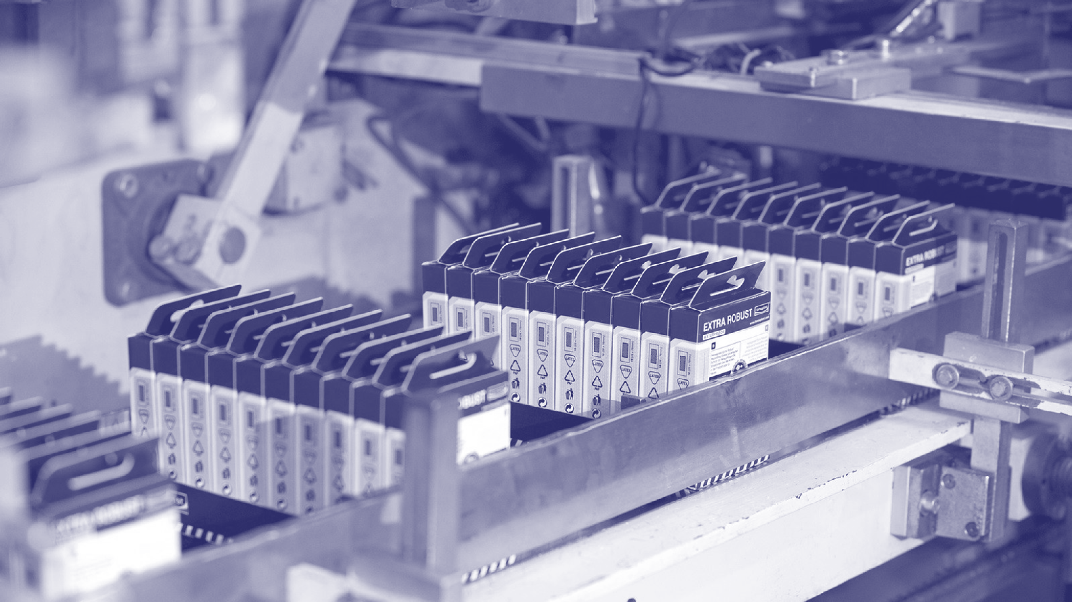
Output

Slide 19
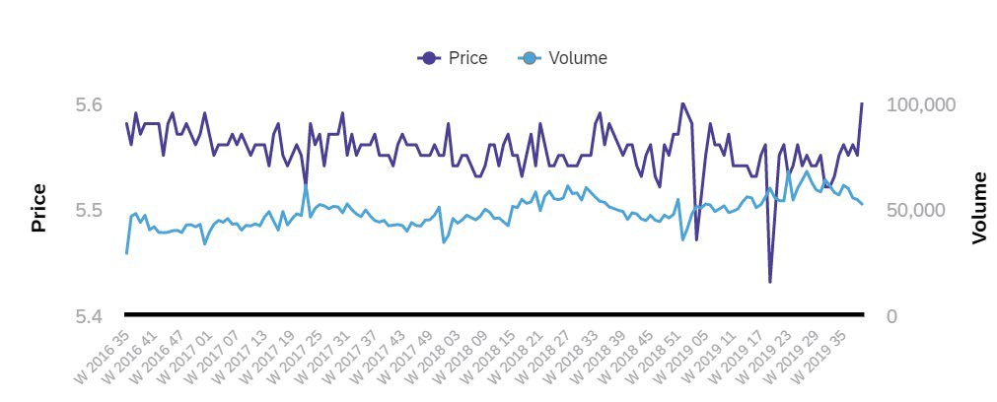
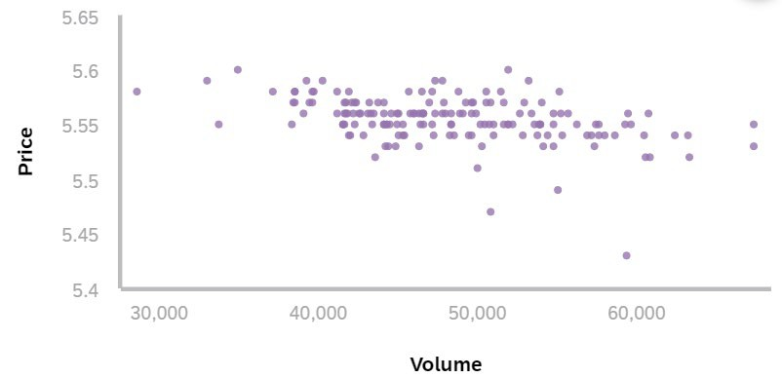
Demand curves didn’t show a strong relationship between price and quantity demanded
Example plots: Hansaplast Classic Streifen Classic 2M X 6M 1 ST
Price and Volume change over time
Price and Volume plot per week

Slide 20


Regression results for 8 out of the 40 products examined demonstrated non-significant price elasticity coefficient (but significant coef for TDP)
EIGENMARKE DIVERSE 24 ST + FINGERPFLASTER EIGENMARKE DIVERSE 10 ST + FINGERPFLASTER EIGENMARKE DIVERSE 28 ST + FINGERPFLASTER EIGENMARKE 6 CM X 10 CM 20 ST + METERWARE
HANSAPLAST SPRUEHPFLASTER SPRAY 1 ST + SPRUEHPFLASTER HANSAPLAST SENSITIVE PFLASTER XXL 5 ST + XL/XXL HANSAPLAST UNIVERSAL STRIPS UNIVERSAL 40 ST + STRIPS FIGO ERSTE HILFE WUNDPFLASTER DIVERSE 36 ST+ STRIPS
Results for other 32 products had both TDP coefficient and price elasticity coefficients significant i.e. demand can be explained partially by changes in price

Slide 21
Demand is more price elastic for BDF products (Hansaplast) and TDP is less impactful to BDF products than to Private Labels
Elasticity and TDP coefficient for all 40 products by brand
Average weekly sales

Slide 22
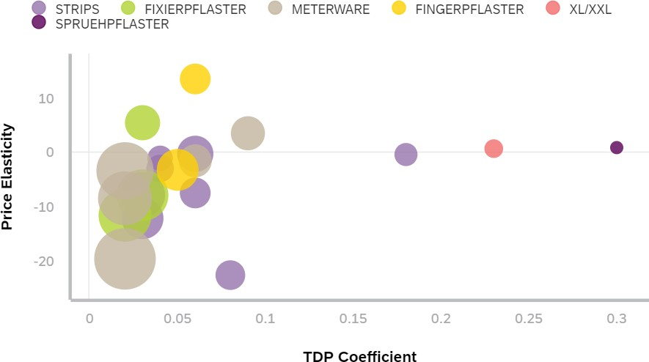
Quantity demanded for BDF products with larger sales was more sensitive to price and less impacted by TDP
Elasticity and TDP coefficient for BDF products by sub-segment
Average weekly sales

Slide 23
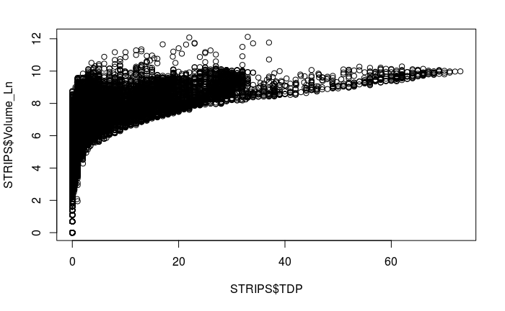
STRIPS - opportunity for BDF to increase brand equity
Fit Variables ^{Adjusted}
R2
Volume_Ln~Price_Ln 6.6%
Volume_Ln~TDP 30.1%
Volume_Ln~Price_Ln+TDP 38.8%
Volume_Ln~Price_Ln+TDP+Brand 55.2%
Volume_Ln~Price_Ln+TDP+Brand+Season 55.5%
Volume_Ln ~ Price_Ln + TDP + Brand+Season + CPI 55.5% Volume_Ln ~ Price_Ln + TDP + Brand+Season + CPI + Temperature 55.5% Volume_Ln ~ Price_Ln + TDP + Brand+Season + CPI + Temperature + Sunshine 55.5%
Variables | Coef | Sig
(Intercept) | 5.2775 | 
Price_Ln | (0.8959) | 
TDP | 0.1518 | 
BrandCOSMOPLAST | (0.4489) | 
BrandDOCMORRIS | 2.3577 | 
BrandHANSAPLAST | (0.2994) | 
BrandKALFF | 0.7641 | 
BrandPRIVATE LABELS | 0.6324 | 
BrandSANA | 0.1972 | 
BrandSANAPLAST | 1.0770 | 
SeasonSpring | 0.0369 | x
SeasonSummer | 0.2931 | 
SeasonWinter | (0.0266) | x
STRIPS segment is price elastic due to negative Price_Ln coefficient
There is a strong relationship between volume of the sales and TDP i.e. weighted distribution
Brand Hansaplast has one of the lowest brand recognition
Seasonality factor - summer time positively influences the sales volume

Slide 24
BDF can increase sales volume by increasing TDP for 1 product in the segment
 |  | Price_Ln |  | TDP |  | Spring |  | Summer |  | Winter |  | CPI |  | Temperature |  | Sunshine
Combo | Adj R2 | Coeff Sign |  | Coeff Sign |  | Coeff Sign |  | Coeff Sign |  | Coeff Sign |  | Coeff Sign |  | Coeff Sign |  | Coeff Sign
HANSAPLAST AQUA PROTECT STRIPS 20 ST | 87.1% | (6.76) | Yes | 0.031 | Yes | (0.010) | No | 0.369 | Yes | 0.044 | No | 0.037 | No | (0.002) | No | 0.001 | Yes
HANSAPLAST SENSITIVE STRIPS 20 ST | 84.8% | (4.72) | Yes | 0.027 | Yes | (0.016) | No | 0.299 | Yes | (0.021) | No | 0.029 | No | (0.007) | No | 0.001 | Yes
HANSAPLAST UNIVERSAL STRIPS 40 ST | 83.3% | 0.11 | No | 0.060 | Yes | 0.023 | No | 0.345 | Yes | (0.005) | No | (0.006) | No | (0.005) | No | 0.001 | Yes
HANSAPLAST DRK MIX PACK DIVERSE 20 ST | 89.6% | (8.04) | Yes | 0.052 | Yes | 0.132 | Yes | 0.334 | Yes | 0.144 | No | 0.156 | Yes | 0.006 | No | 0.001 | Yes
HANSAPLAST WATERPROOF 16 ST | 72.7% | (6.33) | Yes | 0.050 | Yes | 0.041 | No | 0.413 | Yes | (0.018) | No | 0.173 | Yes | 0.001 | No | 0.000 | No
HANSAPLAST STREIFEN ELASTIC 20 ST | 69.8% | (1.64) | No | 0.050 | Yes | 0.150 | Yes | 0.376 | Yes | 0.019 | No | 0.221 | Yes | 0.002 | No | 0.000 | No
HANSAPLAST SILICONE SOFT DIVERSE 8 ST | 61.9% | (21.68) | Yes | 0.063 | Yes | 0.281 | No | 0.615 | Yes | 0.133 | No | 0.078 | No | (0.010) | No | 0.002 | No
HANSAPLAST KIDS FROZEN DIVERSE 16 ST | 71.1% | (0.78) | Yes | 0.198 | Yes | 0.434 | Yes | 0.589 | Yes | 0.381 | Yes | 0.380 | Yes | (0.051) | Yes | 0.002 | No
EIGENMARKE DIVERSE 20 ST | 51.3% | (0.16) | Yes | 0.146 | Yes | (0.083) | No | 0.079 | No | 0.065 | No | 0.118 | Yes | 0.012 | No | 0.000 | No
EIGENMARKE 8 CM X 10 CM 5 ST | 56.0% | 1.40 | Yes | 0.144 | Yes | 0.204 | No | 0.536 | Yes | (0.278) | No | (0.102) | No | (0.102) | Yes | 0.004 | Yes
EIGENMARKE DIVERSE 40 ST | 36.4% | 0.33 | Yes | 0.208 | Yes | 0.096 | No | 0.369 | Yes | 0.058 | No | (0.350) | Yes | 0.026 | No | (0.002) | No
EIGENMARKE DIVERSE 24 ST | 64.8% | (0.68) |  |  | Yes
 |  |  | No | 0.188 |  | - NA |  | (0.168) | No | 0.157 | No | 0.481 | No | 0.120 | No | 0.003 | No
EIGENMARKE DIVERSE 16 ST | 74.1% | 3.51 |  |  | Yes
 |  |  | Yes | 0.168 |  | (0.154) | No | 0.592 | Yes | (0.445) | Yes | 0.460 | Yes | (0.034) | No | 0.002 | No
EIGENMARKE WUNDSCHNELLVERBAENDE | 67.3% | (4.36) |  |  | Yes |  |  |  | Yes
 |  |  | Yes | 0.086 |  | 1.497 | Yes | (0.992) |  | - NA |  | (0.071) | No | 0.267 | Yes | 0.002 | No
EIGENMARKE DIVERSE 30 ST | 16.7% | (0.31) |  |  | Yes |  |  |  |  |  |  |  | No
 |  |  | Yes | 0.228 |  | 0.086 | No | 0.064 | No | 0.076 | No | 0.032 |  | (0.004) | No | (0.000) | No
EIGENMARKE DIVERSE 10 ST | 73.1% | (0.43) |  |  | Yes |  | No |  | No |  |  |  |  |  | No
 |  |  | Yes | 0.336 |  | (0.119) |  | 0.171 |  | 0.071 | No | (0.319) | Yes | (0.011) |  | 0.003 | Yes
FIGO ERSTE HILFE DIVERSE 36 ST | 76.0% | 1.19 |  |  | Yes |  |  |  |  |  |  |  | Yes |  |  |  | Yes
 |  |  | No | 0.277 |  | 0.395 | Yes | 0.988 | Yes | (0.130) | No | (0.281) |  | (0.067) | Yes | 0.004
TDP explains most of the variation in volume for Hansaplast products.
Further increase in TDP provides only marginal positive impact (ex. 0.05 vs 0.18 for private labels)
HANSAPLAST KIDS FROZEN
DIVERSE 16 ST has a high TDP coefficient i.e. additional sales can be obtained by increasing TDP
iv. HANSAPLAST SILICONE SOFT DIVERSE 8 ST – no
further price increases are recommended
Summer season along with sunshine duration positively influences demand from customers
iii.
Fit Variables
Adj R2
 | Volume_Ln~Price_Ln | 8.7% | v.
 | Volume_Ln~TDP | 69.9%
 | Volume_Ln~Price_Ln+TDP | 74.5%
 | Volume_Ln~Price_Ln+TDP+Season | 86.2%
 | Volume_Ln ~ Price_Ln + TDP + Season + CPI | 86.3%
 | Volume_Ln ~ Price_Ln + TDP + Season + CPI + Temperature | 86.6%
Page 20 | Volume_Ln ~ Price_Ln + TDP + Season + CPI + Temperature + Sunshine | 87.1%

Slide 25
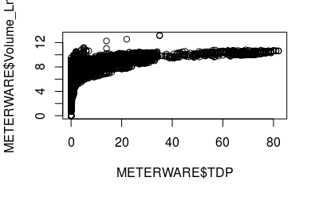
METERWARE - opportunity for BDF to increase brand equity
Fit Variables ^{Adjusted}
R2
Volume_Ln~Price_Ln 2.19%
Volume_Ln~TDP 30.88%
Volume_Ln~Price_Ln+TDP 36.73%
Volume_Ln~Price_Ln+TDP+Brand 51.40%
Volume_Ln~Price_Ln+TDP+Brand+Season 51.52%
Volume_Ln ~ Price_Ln + TDP + Brand+Season + CPI 51.51% Volume_Ln ~ Price_Ln + TDP + Brand+Season + CPI + Temperature 51.51% Volume_Ln ~ Price_Ln + TDP + Brand+Season + CPI + Temperature + Sun 51.51%
 | Variables | Coef | Sig
 | (Intercept) | 4.4758 | 
 | Price_Ln | (0.1728) | 
 | TDP | 0.1119 | 
 | BrandDUKAPLAST | 0.8920 | 
 | BrandGOTHAPLAST | 0.2883 | 
 | BrandHANSAPLAST | (0.1171) | x
 | BrandKALFF | 1.4158 | 
 | BrandPRIVATE LABELS | 1.9004 | 
 | BrandSANA | 1.1186 | 
 | SeasonSpring | 0.1110 | 
 | SeasonSummer | 0.2560 | 
Page 21 | SeasonWinter | 0.0960 | 
METERWARE segment is marginally price elastic due to neutral Price_Ln coefficient
There is a strong relationship between volume of the sales and TDP i.e. weighted distribution
Brand Hansaplast has one of the lowest brand recognition, but its coefficient is not significant
Seasonality factor - summer time positively influences the sales volume

Slide 26
BDF can increase sales volume by increasing TDP for 2 products in the segment
Combo Adj R2 HANSAPLAST STREIFEN CLASSIC 2 M X 6 CM 1 ST 84.3% HANSAPLAST STREIFEN CLASSIC 1 M X 6 CM 1 ST 83.2% HANSAPLAST WUNDPFLASTER SENSITIV 1 M X 6 CM 1 ST 85.2% HANSAPLAST UNIVERSAL STREIFEN 1 M X 6 CM 1 ST 82.8% HANSAPLAST ELASTIC STREIFEN 1 M X 6 CM 1 ST 82.6% EIGENMARKE 10 CM X 6 CM 10 ST 37.3% EIGENMARKE 1 M X 6 CM 1 ST 37.3% EIGENMARKE 6 CM X 10 CM 20 ST 42.1% | Price_Ln |  | TDP |  | Season_Spring |  | Season_Summer |  | Season_Winter |  | CPI |  | Temperature |  | Sunshine
 | Coeff Sign |  | Coeff Sign |  | Coeff Sign |  | Coeff Sign |  | Coeff Sign |  | Coeff Sign |  | Coeff Sign |  | Coeff Sign
 | (12.730) (2.252) (5.437) (0.696) 0.669 0.169 0.169 (1.875) | Yes Yes Yes | 0.025 0.023 0.025 0.060 0.094 0.150 0.150 0.162 | Yes Yes Yes Yes Yes Yes Yes Yes | 0.007 0.004 (0.039) (0.015) 0.046 (0.146) (0.146) 0.010 | No No No No No No No No | 0.294 0.298 0.277 0.350 0.356 (0.098) (0.098) 0.183 | Yes Yes Yes Yes Yes | 0.028 (0.016) (0.026) (0.067) (0.062) 0.051 0.051 0.081 | No No No No No No No No | 0.020 (0.017) 0.019 (0.017) 0.067 (0.096) (0.096) (0.039) | No No No No No No No No | (0.008) (0.006) (0.011) (0.013) (0.004) (0.008) (0.008) (0.001) | No No No | 0.001 0.001 0.001 - 0.001 0.001 0.001 0.000 | Yes Yes Yes Yes Yes
 |  | No No |  |  |  |  |  |  |  |  |  |  |  | Yes
 |  |  |  |  |  |  |  |  |  |  |  |  |  | No No No No
 |  | Yes Yes |  |  |  |  |  | No No No |  |  |  |  |  |  |  | No No No
 |  | No
Fit Variables Adj R2
Volume_Ln~Price_Ln 2.0%
Volume_Ln~TDP 74.1%
Volume_Ln~Price_Ln+TDP 75.4%
Volume_Ln~Price_Ln+TDP+Season 83.6%
Volume_Ln ~ Price_Ln + TDP + Season + CPI 83.6%
Volume_Ln ~ Price_Ln + TDP + Season + CPI + Temperature 83.7% Volume_Ln ~ Price_Ln + TDP + Season + CPI + Temperature + Sunshine 84.3%
TDP explains most of the variation in volume for Hansaplast products.
HANSAPLAST ELASTIC STREIFEN 1 M X 6 CM 1 ST and HANSAPLAST
UNIVERSAL STREIFEN 1 M X 6 CM 1 ST have better TDP coefficients
i.e. additional sales can be obtained by increasing TDP
Demand for private labels, the main competition, is only partially explained by price and TDP
Summer season along with sunshine duration positively infuences demand from customers

Slide 27


Recommendations
Increase prices for select products with positive price elasticity coefficient
Increase TDP for products with higher than market TDP coefficients
Design brand recognition campaigns for segments with the lowest brand recognition scores
Review SKUs and engage in SKU rationalization to strengthen the brand
Increase prices during
summer and conduct
promotional campaigns
during other seasons

Slide 28
Appendix

Slide 29
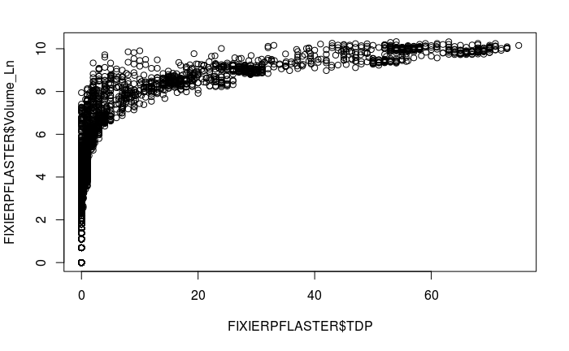
BDF has medium brand equity in FIXIERPFLASTER segment
Fit Variables ^{Adjusted}
R2
Volume_Ln~Price_Ln 1.01%
Volume_Ln~TDP 49.58%
Volume_Ln~Price_Ln+TDP 50.08%
Volume_Ln~Price_Ln+TDP+Brand 69.94%
Volume_Ln~Price_Ln+TDP+Brand+Season 70.10%
Volume_Ln ~ Price_Ln + TDP + Brand+Season + CPI 70.13% Volume_Ln ~ Price_Ln + TDP + Brand+Season + CPI + Temperature 70.16% Volume_Ln ~ Price_Ln + TDP + Brand+Season + CPI + Temperature + Sunshine 70.18%
Variables | Coef | Sig
(Intercept) | 4.3858 | 
Price_Ln | (0.1470) | 
TDP | 0.1002 | 
BrandGOTHAPLAST | 1.0635 | 
BrandHANSAPLAST | 0.6242 | 
BrandOTHERS | (0.2182) | 
BrandPAPSTAR | (0.3087) | 
BrandPRIVATE LABELS | 1.2668 | 
SeasonSpring | 0.0422 | X
SeasonSummer | 0.2499 | 
SeasonWinter | (0.0334) | X
FIXIERPFLASTER segment is marginally price elastic due to almost neutral Price_Ln coefficient
There is a strong relationship between volume of the sales and TDP i.e. weighted distribution
Brand Hansaplast has 3rd strongest recognition after private labels and Gothaplast
Seasonality factor - summer time positively influences the sales volume

Slide 30
BDF can increase price for 1 product in the segment but most demand is driven by TDP with marginal returns
 |  | Price_Ln |  | TDP |  | Season_Spring |  | Season_Summer |  | Season_Winter |  | CPI |  | Temperature |  | Sunshine
Product Name | Adj R2 | Coeff Sign |  | Coeff Sign |  | Coeff | Sign | Coeff | Sign | Coeff | Sign | Coeff Sign |  | Coeff Sign |  | Coeff Sign
HANSAPLAST SENSITIVE 5 M X 2.5 CM 1 ST | 84.9% | (8.847) | Yes | 0.026 | Yes | (0.035) | No | 0.255 | Yes | (0.017) | No | 0.056 | No | (0.003) | No | 0.001 | Yes
HANSAPLAST CLASSIC 5 M X 2.5 CM 1 ST | 85.1% | (5.114) | Yes | 0.032 | Yes | (0.009) | No | 0.280 | Yes | (0.021) | No | 0.033 | No | (0.009) | No | 0.001 | Yes
HANSAPLAST CLASSIC 5 M X 1.25 CM 1 ST | 76.3% | 4.760 | Yes | 0.036 | Yes | 0.033 | No | 0.313 | Yes | (0.009) | No | 0.111 | Yes | (0.014) | No | 0.001 | Yes
EIGENMARKE 5 M X 2.5 CM 1 ST | 68.2% | 1.108 | Yes | 0.180 | Yes | 0.118 | No | 0.222 | No | 0.004 | No | 0.056 | No | (0.023) | No | 0.002 | No
Adjusted R2
2.4%
75.3%
77.3%
84.5%
84.7%
84.7%
84.9%
TDP explains most of the variation in volume for Hansaplast product. Further increase in TDP provides only marginal positive
impact (ex. 0.03 vs 0.18 for private labels)
Private labels have more capacity to increase prices and to increase TDP for growing demand
HANSAPLAST CLASSIC 5 M X 1.25 CM 1 ST has positive Price_Ln coefficint i.e. price of this product can be increased
Summer season along with sunshine duration and temperature positively infuence demand from customers
Fit Variables
Volume_Ln~Price_Ln Volume_Ln~TDP Volume_Ln~Price_Ln+TDP Volume_Ln~Price_Ln+TDP+Season
Volume_Ln ~ Price_Ln + TDP + Season + CPI Volume_Ln ~ Price_Ln + TDP + Season + CPI + Temp
Volume_Ln ~ Price_Ln + TDP + Season + CPI + Temp + Sun

Slide 31
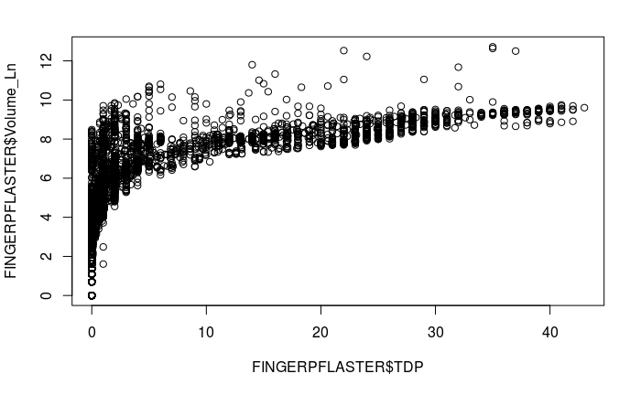
BDF has strong brand equity in FINGERPFLASTER segment
Fit Variables Adjusted R2
Volume_Ln~Price_Ln 0.63%
Volume_Ln~TDP 45.43%
Volume_Ln~Price_Ln+TDP 47.05%
Volume_Ln~Price_Ln+TDP+Brand 64.08%
Volume_Ln~Price_Ln+TDP+Brand+Season 64.22%
Volume_Ln ~ Price_Ln + TDP + Brand+Season + CPI 64.24% Volume_Ln ~ Price_Ln + TDP + Brand+Season + CPI + Temperature 64.25% Volume_Ln ~ Price_Ln + TDP + Brand+Season + CPI + Temperature + Suns 64.25%
Variables | Coef | Sig
(Intercept) | 3.9901 | 
Price_Ln | (1.0818) | 
TDP | 0.1342 | 
BrandGOTHAPLAST | 0.9338 | 
BrandHANSAPLAST | 2.1888 | 
BrandPRIVATE LABELS | 2.2120 | 
SeasonSpring | (0.0228) | X
SeasonSummer | 0.2304 | 
SeasonWinter | 0.0066 | X
FINGERPFLASTER segment is price elastic due to negative Price_Ln coefficient
There is a strong relationship between volume of the sales and TDP i.e. weighted distribution
Brand Hansaplast has 2nd strongest recognition after private labels
Seasonality factor - summer time positively influences the sales volume

Slide 32
BDF can increase price for 1 product in the segment but most demand is driven by TDP with marginal returns
 |  | Price_Ln |  | TDP |  | Spring |  | Summer |  | Winter |  | CPI |  | Temperature |  | Sunshine
Product Name | Adjusted R2 | Coeff Sign |  | Coeff Sign |  | Coeff | Sign | Coeff | Sign | Coeff | Sign | Coeff | Sign | Coeff | Sign | Coeff | Sign
HANSAPLAST SELBSTHAFTENDER 5 M X 2.5 CM 1 ST | 65.0% | 14.30 | Yes | 0.05 | Yes | 0.2197 | No | 0.4547 | Yes | 0.0337 | No | 0.3558 | Yes | (0.0631) | Yes | 0.0030 | Yes
HANSAPLAST FINGERSTRIPS 1.9 CM X 12 CM 16 ST | 84.2% | (2.54) | Yes | 0.05 | Yes | 0.0347 | No | 0.3232 | Yes | (0.0494) | No | 0.0069 | No | (0.0190) | Yes | 0.0009 | Yes
EIGENMARKE DIVERSE 24 ST | 58.2% | 0.03 | No | 0.14 | Yes | (0.0818) | No | (0.3848) | No | (0.1191) | No | 0.6992 | Yes | 0.1003 | No | (0.0001) | No
EIGENMARKE DIVERSE 28 ST | 41.7% | 1.18 | No | 0.50 | Yes | 0.0989 | No | 0.5146 | Yes | 0.3854 | Yes | 0.2195 | No | (0.0357) | No | 0.0015 | No
EIGENMARKE DIVERSE 16 ST | 73.5% | 3.37 | Yes | 0.16 | Yes | (0.1014) | No | 0.0496 | No | 0.0088 | No | (0.0175) | No | (0.0310) | Yes | (0.0002) | No
EIGENMARKE DIVERSE 10 ST | 77.0% | 5.43 | No | 0.32 | Yes | 0.0832 | No | 0.2724 | Yes | 0.0325 | No | 0.0544 | No | (0.0017) | No | 0.0009 | No
EIGENMARKE 2.5 CM X 4 M 1 ST | 54.6% | 2.72 | Yes | 0.17 | Yes | (0.1033) | No | 0.4077 | No | (0.1784) | No | 0.0252 | No | (0.0298) | No | 0.0010 | No
Fit Variables Adjusted R2
Volume_Ln~Price_Ln 2.2%
Volume_Ln~TDP 79.2%
Volume_Ln~Price_Ln+TDP 80.4%
Volume_Ln~Price_Ln+TDP+Season 83.8%
Volume_Ln ~ Price_Ln + TDP + Season + CPI 83.7%
Volume_Ln ~ Price_Ln + TDP + Season + CPI + Temp 83.9% Volume_Ln ~ Price_Ln + TDP + Season + CPI + Temp + Sun 84.2%
TDP explains most of the variation in volume for Hansaplast product. Further increase in TDP provides only marginal positive
impact (ex. 0.05 vs 0.14 to 0.50 for private labels)
Private labels have more capacity to increase prices and to increase TDP for growing demand
HANSAPLAST SELBSTHAFTENDER 5 M X 2.5 CM 1 ST has positive
Price_Ln coefficint i.e. price of this product can be increased
Summer season along with sunshine duration and temperature positively infuence demand from customers

Slide 33
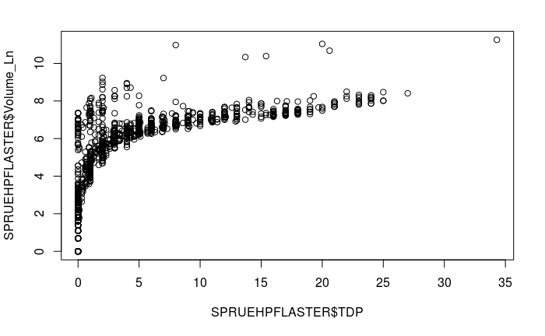
Increase price and TDP in SPRUEHPFLASTER segment
Fit Variables Adj R2
Volume_Ln~Price_Ln 18.2%
Volume_Ln~TDP 40.6%
Volume_Ln~Price_Ln+TDP 53.1%
Volume_Ln~Price_Ln+TDP+Brand 53.4%
Volume_Ln~Price_Ln+TDP+Brand+Season 55.1%
Volume_Ln ~ Price_Ln + TDP + Brand+Season + CPI 55.0% Volume_Ln ~ Price_Ln + TDP + Brand+Season + CPI + Temp 55.3% Volume_Ln ~ Price_Ln + TDP + Brand+Season + CPI + Temp + Sun 55.4%
Product Name HANSAPLAST SPRUEHPFLASTER SPRAY 1 ST EIGENMARKE 1 ST
Adj R2
78.6%
47.7%
Price_Ln |  | TDP |  | Spring |  | Summer
Coeff Sign |  | Coeff Sign |  | Coeff Sign |  | Coeff Sign
0.900 2.262 | No | 0.291 0.250 | Yes | 0.009 0.240 | No | 0.396 0.356 | Yes
 | Yes |  | Yes |  | No |  | No
Segment is more price inelastic, and BDF can increase price for its product HANSAPLAST SPRUEHPFLASTER SPRAY 1 ST and get increase in the demand from the customers
Further increase in TDP will also provide sizable positive impact on sales volume (ex. 0.29 vs 0.25 for private labels)
Summer season positively influences demand from customers

Slide 34
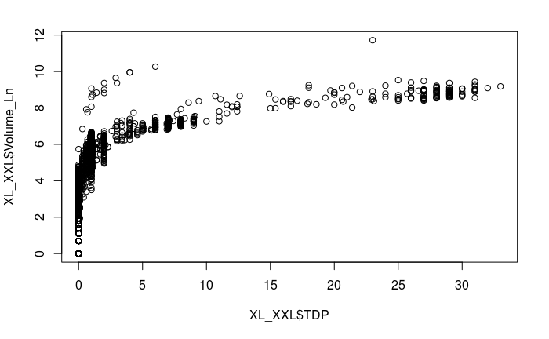
Increase TDP in SPRUEHPFLASTER segment
Fit Variables Adj R2
Volume_Ln~Price_Ln 9.9%
Volume_Ln~TDP 42.5%
Volume_Ln~Price_Ln+TDP 45.3%
Volume_Ln~Price_Ln+TDP+Brand 63.2%
Volume_Ln~Price_Ln+TDP+Brand+Season 63.2%
Volume_Ln ~ Price_Ln + TDP + Brand+Season + CPI 63.2% Volume_Ln ~ Price_Ln + TDP + Brand+Season + CPI + Temp 63.3% Volume_Ln ~ Price_Ln + TDP + Brand+Season + CPI + Temp + 63.5%
Price_Ln |  | TDP | SeasonSpring |  | SeasonSummer | Temperature |  | Sunshine
Coeff | Sign | Coeff Sign | Coeff | Sign | Coeff Sign | Coeff Sign |  | Coeff Sign
8.41 | Yes | 0.114 Yes | (0.641) | Yes | (0.649) Yes | (0.027) | No | 0.004 | Yes
0.69 | No | 0.257 Yes | 0.109 | No | 0.677 Yes | (0.029) | Yes | 0.001 | No
Product Name EIGENMARKE XXL 5 ST HANSAPLAST SENSITIVE XXL 5 ST
Adjusted R2
63.5%
75.2%
Segment is price elastic but Hansaplast enjoys strongest brand recognition
Further increase in TDP for HANSAPLAST SENSITIVE XXL 5 ST will provide a sizable positive impact on sales volume (ex. 0.26 vs 0.11 for private labels)
Summer season positively influences demand from customers
iii.

Slide 35
Beiersdorf has less products than Private Labels
Average Weekly Numbers of Product SKU
140
120
100
80
60
40
20
0
BEIERSDORF
FINGERPFLASTER
HARTMANN
METERWARE
OTHERS PRIVATE LABELS
SPRUEHPFLASTER STRIPS WUNDNAHTPFLASTER XL/XXL
FIXIERPFLASTER

Slide 36
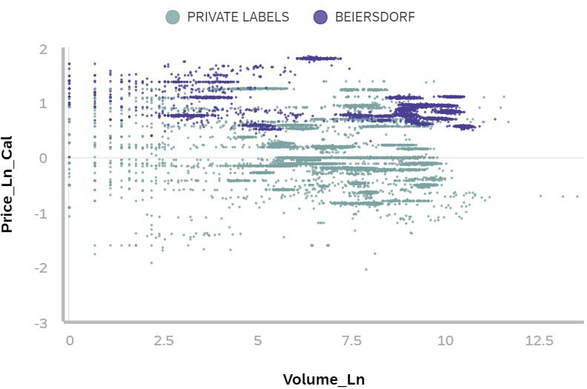
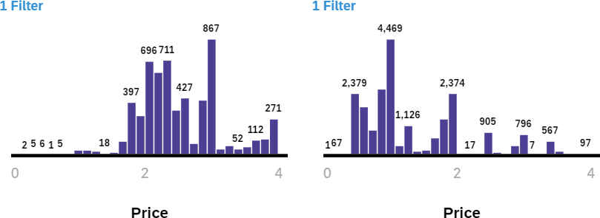
BDF products have higher price points than Private Label products
Ln(Price) and Ln(Volume) plots per product per week
Price distribution per product per week
BDF
Private Label

Slide 37
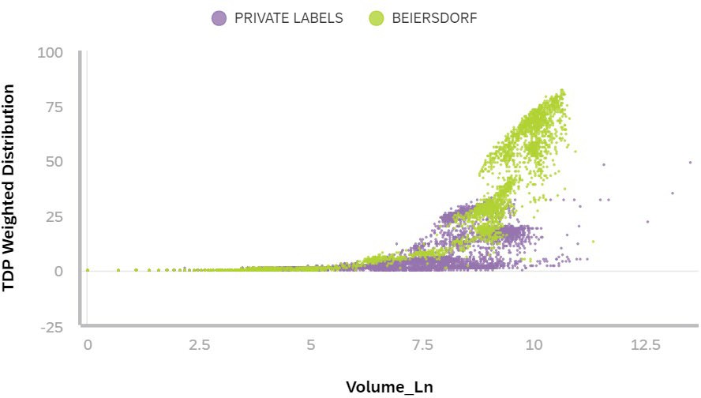
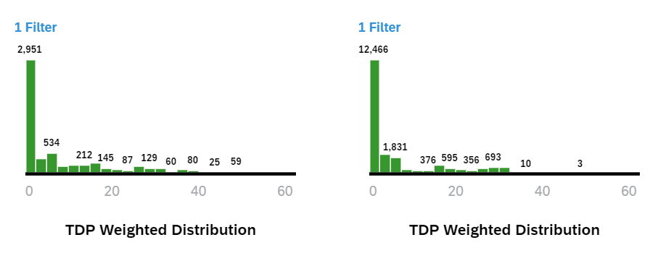
BDF products have higher price points and TDP values than Private Label products
TDP and Ln(Volume) plots per product per week
TDP distribution per product per week
BDF
Private Label

